Slide 1
Welcome to Year 2
Meet & Greet!
Notes:
Hello! We would like to share this powerpoint with you to introduce you to Year 1. We are really pleased with how the children have settled into school and are enjoying their learning so far.

Slide 2
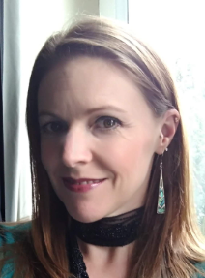
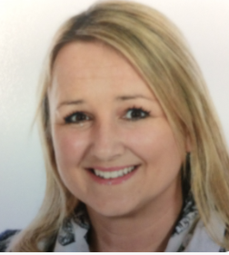
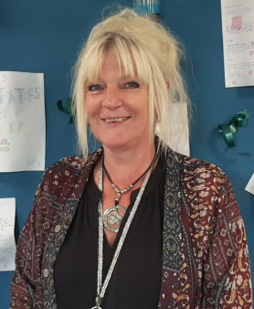
Senior Leadership
Mrs Lord
Head Teacher
Ms Kent
Deputy Head Teacher
Pastoral Support Team
Mrs Hodge ?
SENDCo Pastoral Support Worker
Deputy Safeguarding Lead

Slide 3
Year 2 Team
Mrs Sargeant
Miss Leslie
Mrs Baker (tutor)
Mrs Atkinson (cover/tutor)
Mrs White (HLTA)
Mrs Roberts (TA)

Slide 4
Our Faith Values
Our values are based on Gospel Values and these are central to our school ethos. At CtK the values are embedded into our learning.
Forgiveness
Compassion
Courage
Justice
Kindness
Integrity
Humility
Year 2 focus value is Courage
Notes:
We have been teaching the children the 7cs values. This year in Year 1 we have introduced stories and characters alongside the 7cs. These are:
Caring Chameleon, Courteous Cat, Considerate Caterpillar, Conscientious Camel, Co-operative Chipmunk, Communicative Crab and Confident Cheetah! Why not ask your child to re-tell the stories of all of these characters!

Slide 5
Daily routine
8.30am- Doors open, morning starter tasks
8.40am- Register and morning prayer
8.55am- Phonics and Reading
9.30am- English
10.30am- Break
10.45am- Maths
11.45am- Story time
12.00pm- Play time, then lunch
1.00pm- Register, followed by Meditation or Art Journaling
1.15pm- Combination of Art, Design Technology, Geography, History, Science, RHE or RE
2.40pm- Assembly (whole school or class based)
3.00pm- Home time
The exception is Mondays, when the children have PE in the morning before break time. Thursday afternoons are our non contact time and children have Music and PE then.
Notes:
Our current daily routine consists of the following:
(READ THE SLIDE)
You will notice that we have our snack in the afternoon. This is because the morning is shorter due to an earlier lunch time and by the afternoon we notice this is when the children need the snack and energy boost the most. This timing may adapt over the year, but we will ensure it suits the children's needs.

Slide 6
PE
PE days are on
Monday and Thursday.
Please ensure your children is wearing correct PE uniform (named).
PE Kit
White Polo Top preferable with CtK motif
Navy Blue Shorts
Trainers
Navy tracksuit (winter)
No designer label sports clothing
Velcro trainers unless children have learned to
tie their laces please!
Notes:
Our PE days are on Wednesdays and Fridays. Please send your child into school with their named PE kits on these days. This term we are focusing on ball control.

Slide 7
Reading at Christ the King
Readers need you!​
Read to and with your child daily​.
Read everywhere and anywhere.​
Find a time that works for your child.​
Encourage all efforts​.
Remember that reading makes a huge difference to your child’s life chances. ​
Discuss the text – explain it, say what you think about it, make links to similar books …
Notes:
Reading is a really important part of our curriculum and this continues at home too. How can you help?
READ THE SLIDE

Slide 8
Home Learning
- Daily Reading to an adult, date the circle on the level list fixed into the Record – no need to write book title or anything else, unless you want to write a specific comment about reading
Daily Spellings – Look, Say, Cover, Write, Check
Other Home Learning Log tasks as set (these will often be consolidation of learning the children have completed in class)
Some use of apps with recommended tasks from us, such as IXL, TT Rockstars (Numbots)
Notes:
We have also added some more reading ideas in a message on Marvellous Me for you to use!

Slide 9
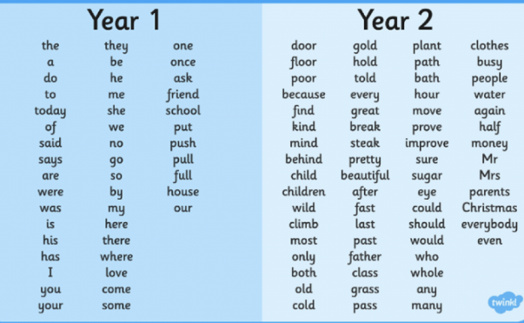
Spellings
The children will be given spellings to learn every FRIDAY. The Home Learning books then need to be back in school every THURSDAY.
At the start of the year, we are revisiting the reading and spelling of words that the children will have already been taught in Year 1. Currently, these include Common Exception words which are words that cannot often be ‘Fred Talked’.
The children are then expected to use these words accurately in their writing books

Slide 10
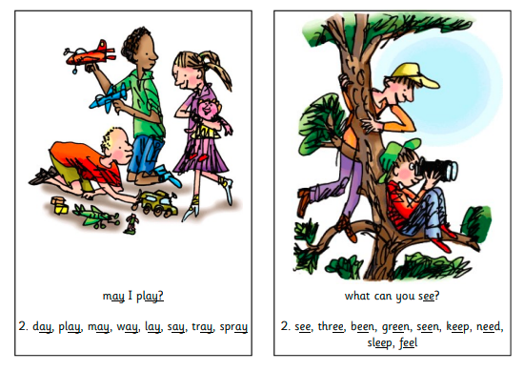
Read Write Inc Phonics

Slide 11
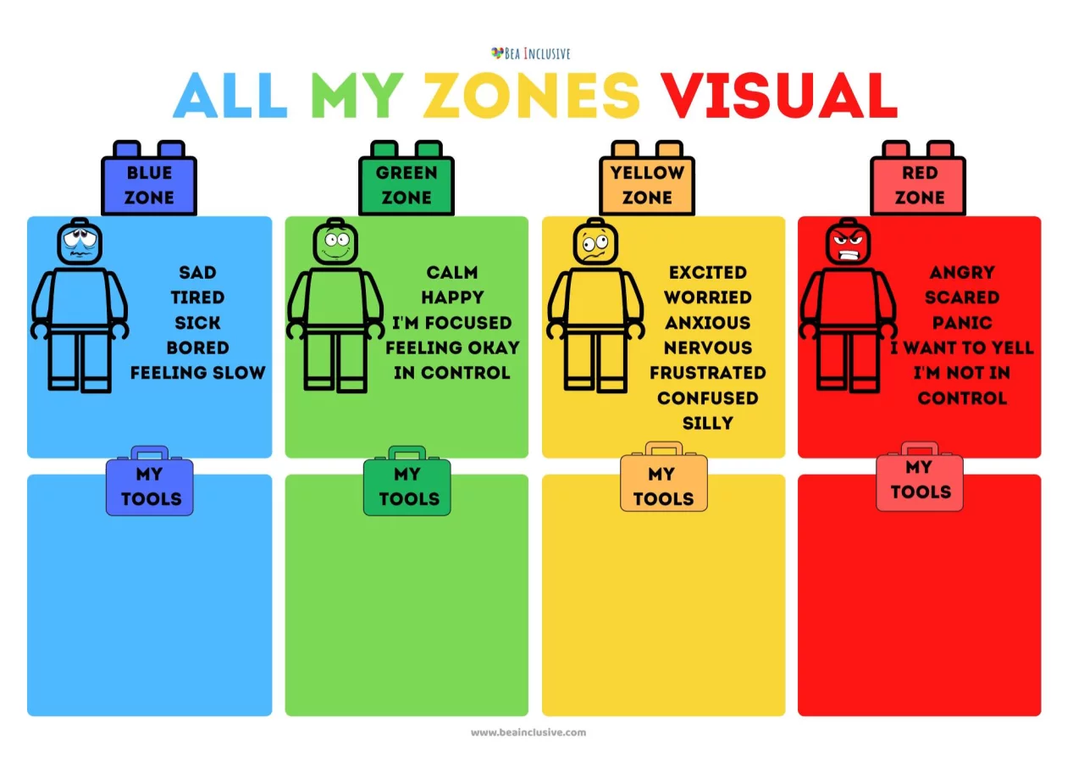
Zones of Regulation

Slide 12
Trick Box:
Notes:
We will be starting to teach the children about some tricks they can use to help them when finding something challenging. These will include deep breaths, speaking positively to themselves and self motivation.

Slide 13
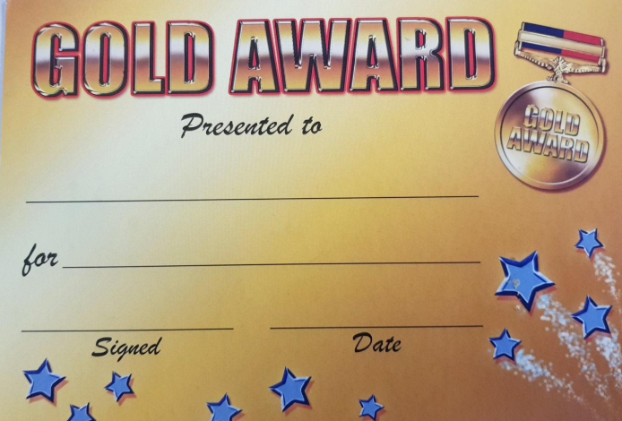
Rewards
Praise/ stickers/ Dojos
Golden Awards
Golden Values Time
Handwriting Heroes
Class rewards-Wow (treat) box, secret student
Notes:
We have a lot of different rewards in Year 1. We focus on positive behaviour management and endeavour to give out lots of stickers throughout the day. Once the children have filled up their sticker chart by earning 20 stickers they are allowed to choose a prize from the prize box. We also choose a secret student at the start of the day who we keep a close eye on through out and then reveal at the end whether this person has earnt their prize by following the rules. The children love this! We give Golden Awards on a Friday to children who have a great week and worked really hard. We also occasionally send Marvellous Me badges home to children who have worked hard during the day.

Slide 14
Communication
Communication
Dojos
Newsletters- Headteachers/year group
Written messages at classroom door
Quick chat by the door after school.
For a longer chat- please phone the office to
make an appointment.
Parent’s Evenings
Thank you for your continued support!
Notes:
Communication is really important and we understand it is very different in this covid world. We will continue to use Tapestry and also the new platform to you this year which is called Marvellous Me. If you would prefer a private conversation with one of the teachers, please call the office to arrange a call back from us. Newsletters are important so please continue to read these. From time to time we will also place notices outside of the classrooms.
Finally, from all the staff in Year 1, thank you so much for all of your continued support so far, we really appreciate it.

Slide 15
Key Dates
21.9.23 | All day | Handball taster sessions
25.9.23 | 3.30pm | MTC times tables parent workshop
27.9.23 | 330pm | KS2 SATs parent workshop
28.9.23 | 2.15pm | EYFS phonics Year 1 phonics screening workshop
29.9.23 | 2.30pm | Grandparent’s Day
5.10.23 | Timings TBC 4-5pm KS1 530-7pm KS2 | Disco PTFA
6.10.23 |  | Family Fast Day + Harvest Mass
7.10.23 |  | Feast of the Holy Rosary - Mary
18.10.23 |  | One million children praying the rosary + flowers for Mary
10.10.23 | 6-730pm | Open Evening for prospective new parents
17.10.23 | All day | Individual photos
17.10.23 19.10.23 | 3- 6pm | Parent consultation evenings
19.10.23 |  | PTFA Crazy Hair Day
20.10.23 |  | INSET

Slide 16
Thank you for taking the time to meet us today!

