Slide 1


Welcome to Year 5
Meet the teacher
Notes:
Hello! We would like to share this powerpoint with you to introduce you to Year 1. We are really pleased with how the children have settled into school and are enjoying their learning so far.

Slide 2
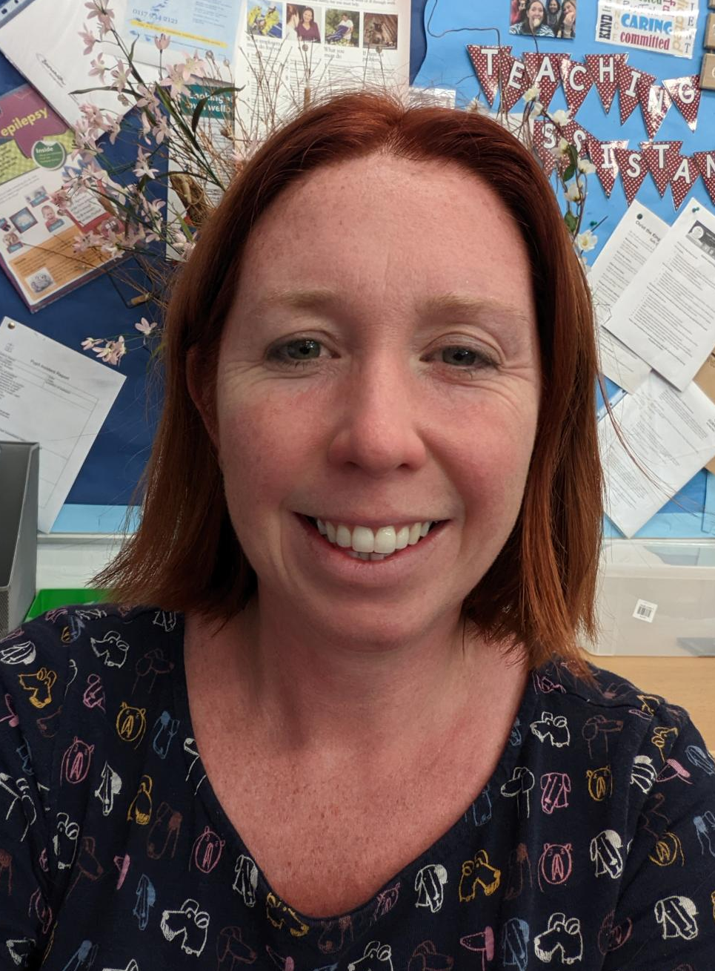
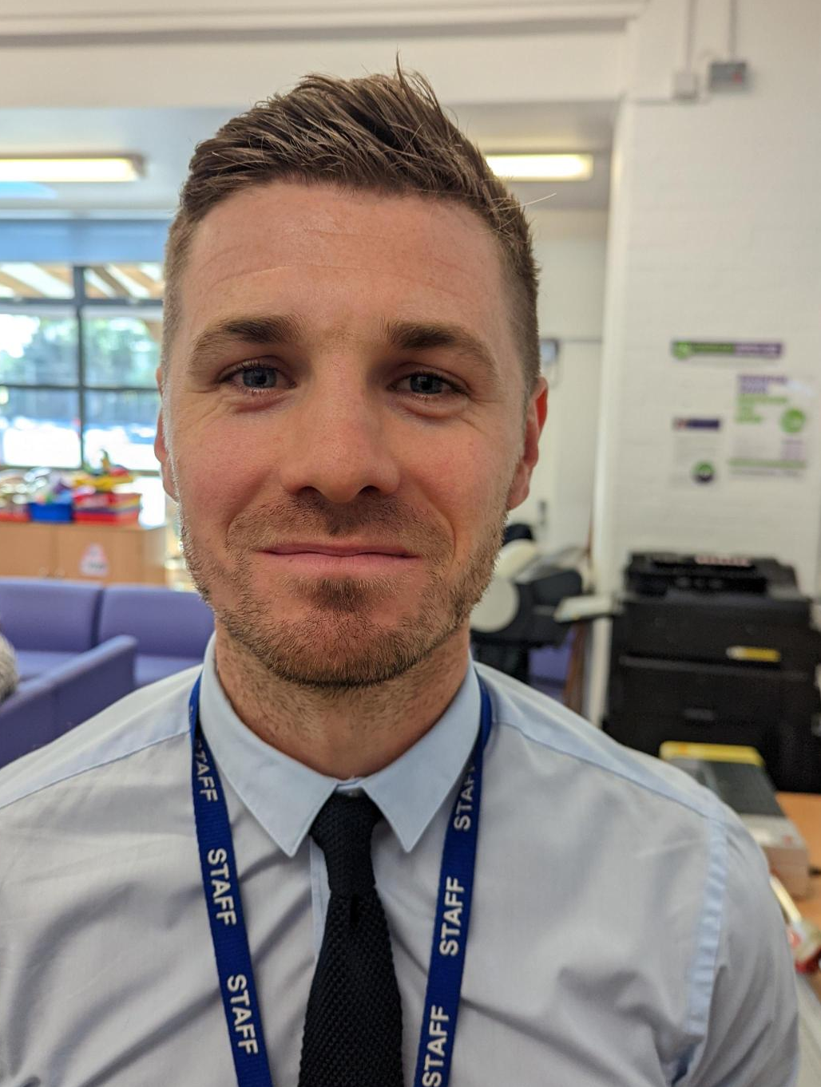
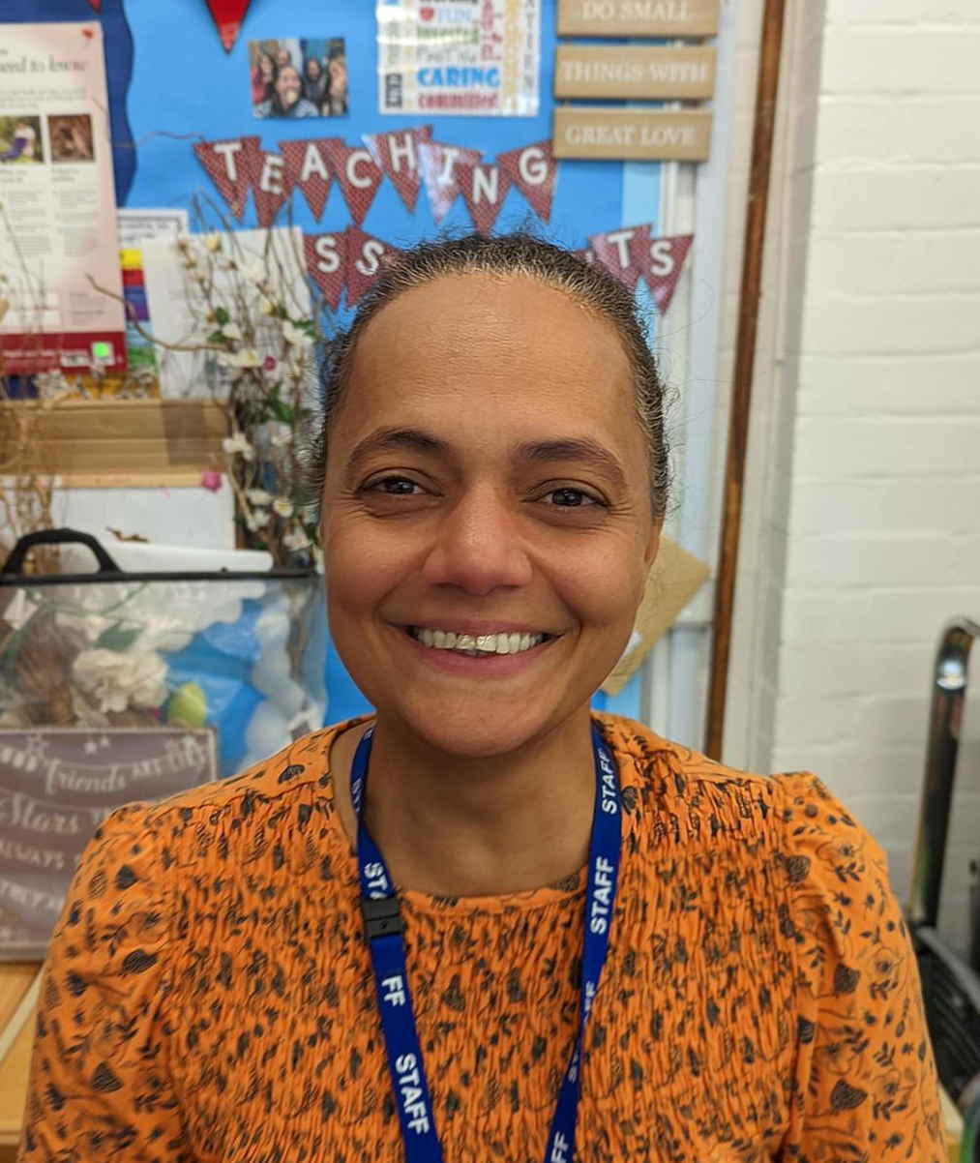
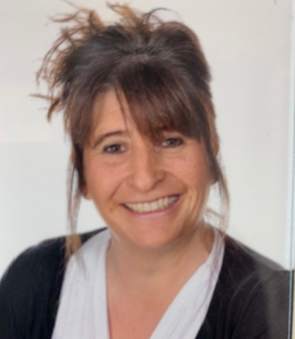
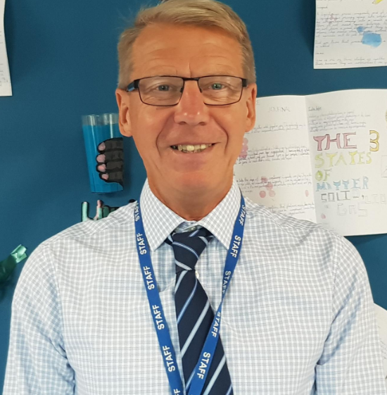
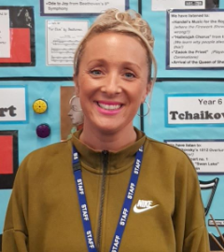
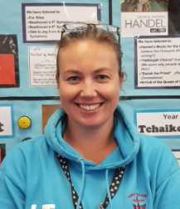
Year 5 team.
Mrs Scott Mr Smith Ms Mellon
Mrs Lane Mr Hancox Mrs Evans Mrs Taylor
Notes:
Firstly let us introduce the staff in year 1 to you. Miss Warr is the Swans class teacher and Mrs Luford is the Robins class teacher.

Slide 3
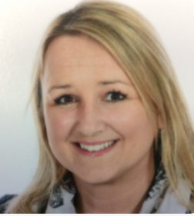
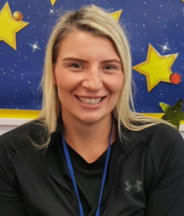
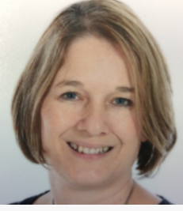
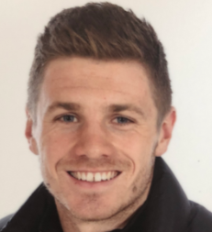
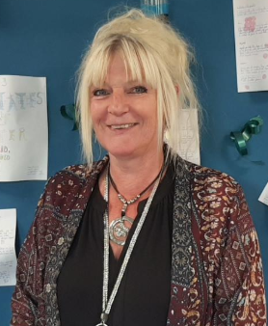
Senior Leadership
Mrs Tickle Mrs Lord Miss 0’Sullivan
Executive Head Teacher Head of School Assistant Head Teacher
Pastoral Support Team
Mr Smith Mrs Hodge
SENCO Pastoral Support Worker
Deputy Safeguarding Lead
Notes:
Firstly let us introduce the staff in year 1 to you. Miss Warr is the Swans class teacher and Mrs Luford is the Robins class teacher.

Slide 4
Our Faith Values
Our values are based on Gospel values and these are central to our school ethos. At CtK the values are embedded into our learning.
Forgiving
Compassion
Courage
Justice
Kindness
Integrity
Humility
Compassion
Year 5 focus value is Integrity
Notes:
We have been teaching the children the 7cs values. This year in Year 1 we have introduced stories and characters alongside the 7cs. These are:
Caring Chameleon, Courteous Cat, Considerate Caterpillar, Conscientious Camel, Co-operative Chipmunk, Communicative Crab and Confident Cheetah! Why not ask your child to re-tell the stories of all of these characters!

Slide 5
Daily routine
8.30am- Doors Open
8.40am- Start of learning/ register completed
8.50am- Reading
9.40am- Writing
10.30am- Play time
10.45am- SPaG
11.10am- Maths
12.10pm- Lunch
1.00pm- Meditation/ PSHE/ DEAR/ Trick Box/ Journaling
1.30pm- RE/ Topic learning/PE
2.30pm- Prayer and praise/ Assembly/ Golden Value Time
2.30pm- Assembly or Class worship in Class
3.00pm- Home time
PE is in the morning on Fridays
Notes:
Our current daily routine consists of the following:
(READ THE SLIDE)
You will notice that we have our snack in the afternoon. This is because the morning is shorter due to an earlier lunch time and by the afternoon we notice this is when the children need the snack and energy boost the most. This timing may adapt over the year, but we will ensure it suits the children's needs.

Slide 6

PE
PE days are on
Monday and Friday.
Please ensure your children is wearing correct PE uniform (named)
PE Kit
White Polo Top preferable with CtK logo.
Navy Blue Shorts
Sports trainers
Navy tracksuit (winter)
No designer label sports clothing
No cycling shorts/compression shorts
Notes:
Our PE days are on Wednesdays and Fridays. Please send your child into school with their named PE kits on these days. This term we are focusing on ball control.

Slide 7
Home Learning
- Daily Reading (reading diary signed)
Daily Spellings
Daily multiplication practice/ TT Rockstar’s
Weekly mathematics/ English tasks, these are set on a Friday and due in on Wednesday
Notes:
We have also added some more reading ideas in a message on Marvellous Me for you to use!

Slide 8
Reading at Christ the King
How can you help?​
Read to and with your child daily​.
Read everywhere and anywhere.​
Find a time that really works for your child​
Encourage all efforts​.
Remember that reading makes a huge difference to your child’s life chances. ​
Discuss the text.
Notes:
Reading is a really important part of our curriculum and this continues at home too. How can you help?
READ THE SLIDE

Slide 9
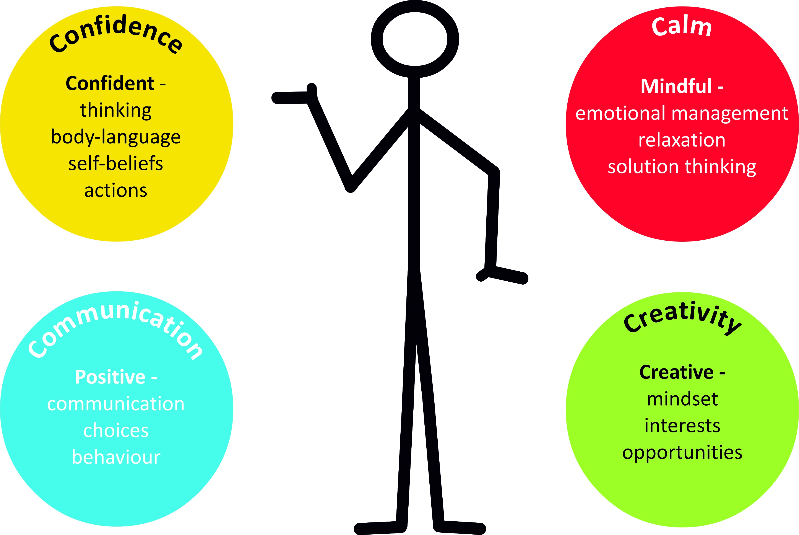

Trick Box:
Notes:
We will be starting to teach the children about some tricks they can use to help them when finding something challenging. These will include deep breaths, speaking positively to themselves and self motivation.

Slide 10
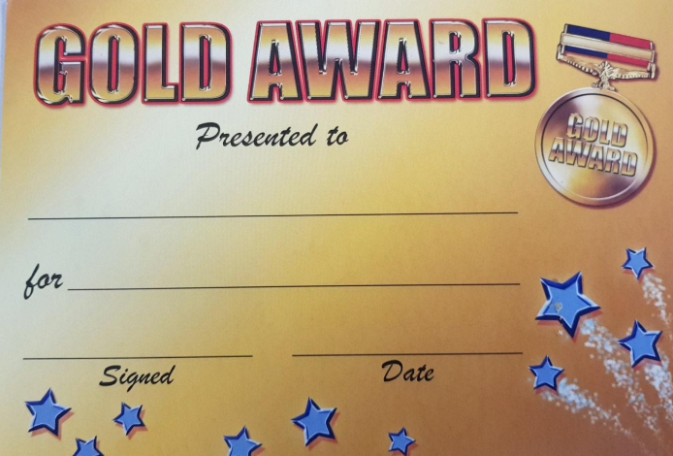
Rewards
Praise/ stickers/ Dojos
Reading Certificates
Golden Awards
Golden Value Time
Class rewards- e.g. Wow box, Treat box
Notes:
We have a lot of different rewards in Year 1. We focus on positive behaviour management and endeavour to give out lots of stickers throughout the day. Once the children have filled up their sticker chart by earning 20 stickers they are allowed to choose a prize from the prize box. We also choose a secret student at the start of the day who we keep a close eye on through out and then reveal at the end whether this person has earnt their prize by following the rules. The children love this! We give Golden Awards on a Friday to children who have a great week and worked really hard. We also occasionally send Marvellous Me badges home to children who have worked hard during the day.

Slide 11
Communication
Communication
Dojos
Newsletters- Headteachers/class
School Facebook
Quick chat by the door before/ after school.
For a longer chat- please phone the office to
make an appointment.
Parent’s Evening
Thank you for your continued support!
Notes:
Communication is really important and we understand it is very different in this covid world. We will continue to use Tapestry and also the new platform to you this year which is called Marvellous Me. If you would prefer a private conversation with one of the teachers, please call the office to arrange a call back from us. Newsletters are important so please continue to read these. From time to time we will also place notices outside of the classrooms.
Finally, from all the staff in Year 1, thank you so much for all of your continued support so far, we really appreciate it.

Slide 12
Key Dates
Wednesday 12th October 2022- Spanish Day. Theme Carnivals
Tuesday 18th October 2022- Individual pupil photographs
Parent’s Evening
Thursday 20th October 2022- Parent’s Evening
Half Term
Monday 24th October to Friday 28th October
Monday 31st October 2022- Inset
Please Note- We NO longer have half days on the last day of term, teaching will continue until 3pm.

Slide 13
School trips
Leeson house
Dates- 8th, 9th and 10th March 2023.
Cost (tbc)

Slide 14
Thank You

